Slide 1
Exploratory Analysis of Product Failures (Phase 1)
Bhanu
Key Findings and Insights

Slide 2
Dataset Overview
Analysis focuses on understanding patterns in product failures
Dataset includes 26,570 product records
Response variable: product failure (Yes / No)
Exploratory analysis only; no predictive modeling

Slide 3
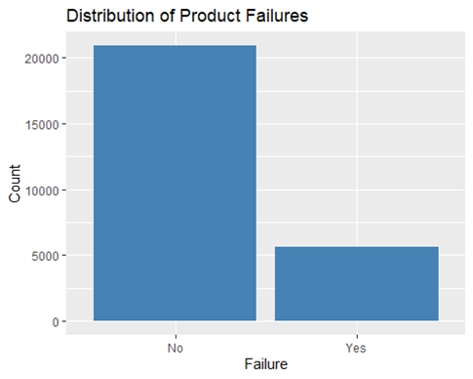
Distribution of Product Failures
Key Points:
• Most products do not fail
• Failures represent a smaller portion of the data
• Indicates an imbalanced outcome variable

Slide 4
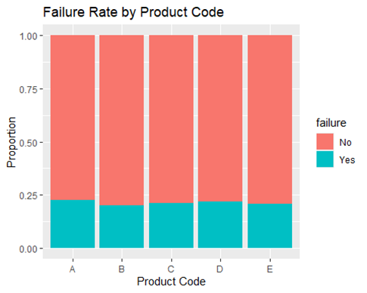
Failure Rate by Product Code
Key Points:
• Failure rates vary across product codes
• Some categories show higher failure proportions
• Product code may be a useful predictor

Slide 5
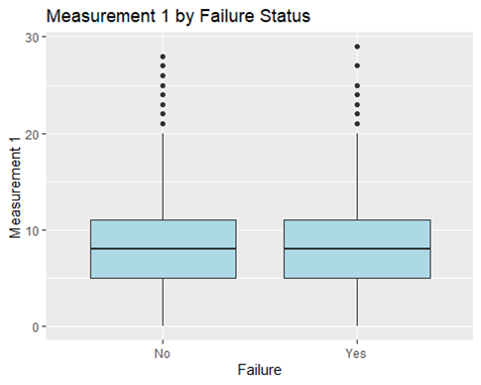
Measurement 1 by Failure Status
Key Points:
• Failed products show a different distribution
• Greater variability observed among failed products
• Measurement variables may help identify failures

Slide 6
Data Quality Observations
Some measurement variables contain missing values
Missingness increases across later measurements
No new variables were created in Phase 1
Missing data will be addressed in Phase 2

Slide 7
Key Insights and Next Steps
Product failures are relatively uncommon
Failure likelihood varies by product category
Numeric measurements differ by failure status
Insights guide predictive modeling in Phase 2

